Slide 1
DeepDive: A Data Management System for Automatic Knowledge Base Construction
Ce Zhang
Department of Computer Sciences
czhang@cs.wisc.edu

Slide 2

DeepDive for Knowledge Base Construction (KBC)
http://deepdive.stanford.edu

Slide 3
Overview
Application
Abstraction
Techniques
Why KBC? How does DeepDive help KBC?
How to build a KBC Application with DeepDive?
How to make DeepDive Efficient and Scalable?
It is feasible to build a data management system to support the end-to-end workflow of building KBC applications.

Slide 4
Overview
Application
Abstraction
Techniques
Why KBC? How does DeepDive help KBC?
How to build a KBC Application with DeepDive?
How to make DeepDive Efficient and Scalable?
Covered in Prelim.
It is feasible to build a data management system to support the end-to-end workflow of building KBC applications.

Slide 5

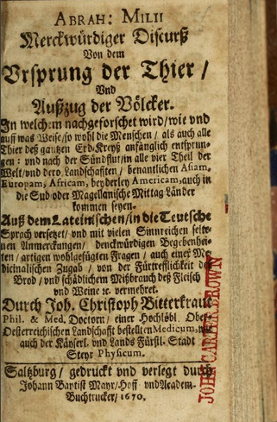
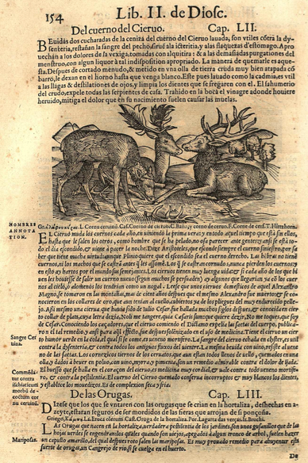
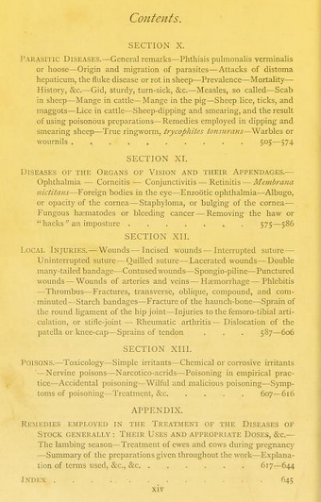
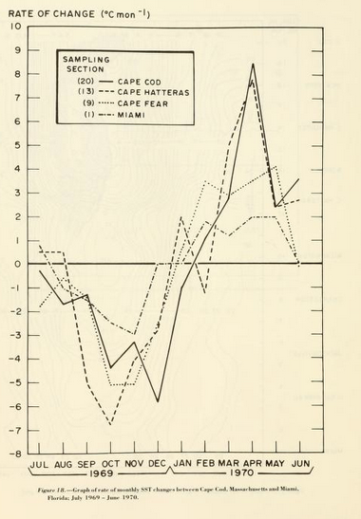
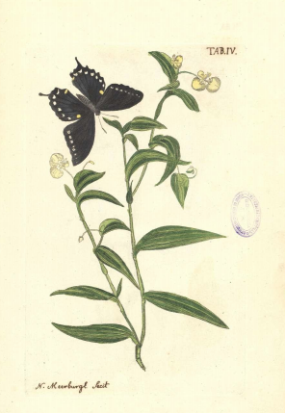
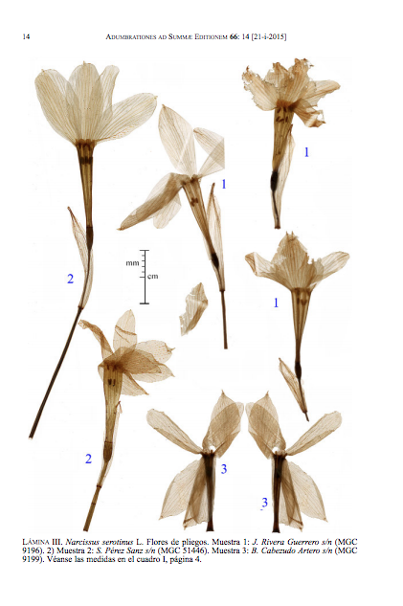








DeepDive Workflow
Feature
Extraction
Feature
Extraction
Statistical Learning
Probabilistic Knowledge Engineering
Statistical Learning & Inference
Input Sources
R.V.
Factor Graph
Supervision Rule
Domain Knowledge Rule
Inference Result
p
External KB
Features
0.9
Feature Extractor
0.6
[IEEE Data Eng. Bull. 2014]

Slide 6
Overview
Application
Abstraction
Techniques
Why KBC? How does DeepDive help KBC?
How to build a KBC Application with DeepDive?
How to make DeepDive Efficient and Scalable?

Slide 7
Technique: Teasers
1. One-shot Execution
Performant and Scalable Statistical Inference and Learning on Modern Hardware.
Techniques
How to make DeepDive Efficient and Scalable?
2.Iterative Execution
Materialization Optimizations to support exploratory iterative development for statistical workload.

Slide 8
Why are there efficiency and scalability
challenges in DeepDive?

Slide 9
Data Flow of PaleoDeepDive
Feature
Extraction
Feature
Extraction
Statistical Learning
Probabilistic Knowledge Engineering
Statistical Learning & Inference
Input Sources
R.V.
0.3B vars
0.7 B factors
Factor Graph
300 K
2 TB
Add a new
rule!
Batch
Execution
Supervision Rule
Domain Knowledge Rule
Inference Result
p
External KB
Add a new
feature!
Features
0.9
> 10 M Tuples
Feature Extractor
3 TB
0.6
Incremental
Maintenance
[IEEE Data Eng. Bull. 2014]

Slide 10
Techniques
Scalable Statistical Inference (via Gibbs sampling) over factor graphs.
Batch
Execution
[SIGMOD 2013]
Performant Statistical Learning on modern hardware.
[VLDB 2014]
Performant Iterative Feature Selection.
Incremental
Maintenance
[SIGMOD 2014]
Performant Iterative Feature Engineering.
[VLDB 2015]

Slide 11
Scalable Gibbs Sampling: System Elementary

Slide 12
Scalable Gibbs Sampling
Goal
Terabytes-scale databases
Scalable Statistical Inference
Data stored in different storages
Contributions
Materialization
Reexamine the impact of classical DB tradeoffs to Gibbs sampling.
Page-oriented Layout
Buffer replacement
Run inference on 6TB factor graphs on a single machine in 1 day
Topic modeling and relation extraction of 1 billion words everyday
[SIGMOD 2013]

Slide 13
Overview
Background: Gibbs sampling & factor graph
Elementary
Experimental Results

Slide 14
Background: Gibbs Sampling & Factor Graph
Variables
Factors
v₁
f₁
If we set v₁ to True, we are rewarded by 5 points!
Probability
F
v₂
f₂
If we set v₂ and v₃ to the
same, we get 10 more points!
T
F
v₃
A “Possible World”
Gibbs Sampling
1. Initialize variables with a random assignment.
T
F
F
v₁
f₁
2. For each random variable:
2.1 Calculate the points we earn for each assignment
e.g., v2= 0 points
v2= 10 points
F
v₂
f₂
T
T
F
2.2 Randomly pick one assignment:
e.g., P(v2= )= exp(0)/(exp(0)+exp(10))
P(v2= )= exp(10)/(exp(0)+exp(10))
F
v₃
T
F
3. Generate one sample. Goto 2 if we want more samples.

Slide 15
Gibbs Sampling as Joins
Variables
Factors
F
v₁
f₁
Edges (E)
Assignments (A)
Variable ID | Factor ID
Variable ID | Assignment
T
v₂
f₂
F
v₃
Variable ID | Factor ID
v2 | f2
Variable ID | Factor ID
v3 | f2
Variable ID | Assignment
v3 | False

Slide 16
More about Joins
v | f | v’ | a
v1 | f1 | v1 | F
v2 | f2 | v2 | T
v2 | f2 | v3 | F
v3 | f2 | v2 | T
v3 | f2 | v3 | F
F
v₁
f₁
New Epoch
v1
T
v₂
f₂
v2
F
v₃
v3
Twist 1
Twist 2
Update the view Q after each variable.
Run sequential scans multiple times in the same order.

Slide 17

Elementary
The State-of-the-art Architecture
v₁
f₁
The Elementary Architecture
F
T
v₂
f₂
Graph in Main Memory
Gibbs Sampler
Storage Backend
Main Memory
Buffer
Gibbs Sampler
Accumulo
HBase
v₃
Unix file
F
Billions!
How classical DB techniques play a role in performance and scalability?

Slide 18
Trade-off Space
Materialization
Page-oriented Layout
Buffer Replacement

Slide 19
Trade-off Space: Materialization
Materialization
LAZY: No Materialization
Page-oriented Layout
V-COC: Materialize QV(v,f,v’) ← E(v,f), E(v’,f)
Lookup Cost
F-COC: Materialize QF(v’,f,a’) ← E(v’,f), A(v’,a’)
Buffer Replacement
EAGER: Materialize Q
Update Cost

Slide 20
Trade-off Space: Page Layout
Materialization
e.g., E(v’, f) in LAZY
Storage
Main Memory Buffer
Random
Access
Request
Tuple
Page-oriented Layout
Buffer Replacement

Slide 21
Trade-off Space: Page Layout
Materialization
e.g., E(v’, f) in LAZY
Storage
Main Memory Buffer
Q1: How to organize relation into pages?
Random
Access
Request
Tuple
Q2: What buffer replacement strategy to use?
Page-oriented Layout
Tuples:
t₁, t₂, …, t_{n}
Visiting Sequence:
t_{a1}, …, t_{am}
Proposition: Finding the optimal paging strategy for f₁,…,f_{n} given visiting sequence t_{a1}, …, t_{am} is NP-hard for LRU or OPTIMAL buffer replacement strategy.
Buffer Replacement
HEURISTIC: Greedily pack f₁,…,f_{n} into pages according to t_{a1}, …, t_{am}.

Slide 22
Trade-off Space: Buffer Replacement
Materialization
e.g., E(v’, f) in LAZY
Secondary Storage
Tuples:
t₁, t₂, …, t_{n}
Visiting Sequence:
t_{a1}, …, t_{am}
Random
Access
Load
Evict
Page-oriented Layout
Main Memory Buffer
LRU: Evict the page that is Least-Recently-Used.
Buffer Replacement
OPTIMAL: Evict the page that will be used latest in the future.

Slide 23
Trade-off Space: Recap
Materialization
4 Strategies
Page-oriented Layout
HEURISTIC
Buffer Replacement
OPTIMAL

Slide 24
Overview
Background: Gibbs sampling & factor graph
Elementary
Experimental Results

Slide 25
Experiments
Main Experiments
End-to-end comparison with other systems.
Trade-off 1: Materialization
Compare LAZY, EAGER, VCOC, FCOC
Trade-off 2: Page-oriented Layout
Compare RANDOM, HEURISTIC
Trade-off 3:Buffer Replacement
Compare LRU, RANDOM, OPTIMAL

Slide 26
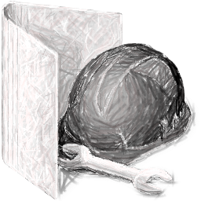


Experiments Setup
LR: Logistic Regression
CRF: Skip-chain CRF
LDA: Latent Dirichlet Allocation
FACTORIE (LR, CRF, LDA)
PGibbs (LR, CRF, LDA)
WinBUGS (LR, LDA)
MADLib (LDA)
Bench (1x)
Scale (100,000x)
 | #Var | #Factor | Size | #Var | #Factor | Size
LR | 47K | 47K | 2MB | 5B | 5B | 0.2TB
CRF | 47K | 94K | 3MB | 5B | 9B | 0.3TB
LDA | 0.4M | 12K | 10MB | 39B | 0.2B | 0.9TB

Slide 27
Main Experiments
40GB Buffer
EleMM
EleMM
MADLib
EleFILE
Other main-
memory Systems
EleFILE
EleHBASE
EleHBASE

Slide 28
Trade-offs: Materialization
CRF (EleFILE)
LDA (EleFILE)
Normalized throughput
Does not finish in 1 hour
Different Page-size/buffer-size settings

Slide 29
Trade-offs: Page-oriented Layout
CRF (EleFILE)
LDA (EleFILE)
Normalized throughput
Does not finish in 1 hour
Different Page-size/buffer-size settings

Slide 30
Trade-offs: Buffer Replacement
CRF (EleFILE)
LDA (EleFILE)
Normalized throughput
Different Page-size/buffer-size settings

Slide 31
Conclusion (of Elementary)
Task
Gibbs Sampling over Factor Graphs.
(Terabyte-scale Factor Graphs!)
Elementary System
Scaling up Gibbs sampling by revisiting classical DB techniques.

Slide 32
Data Flow
Feature
Extraction
Feature
Extraction
Statistical Learning
Probabilistic Knowledge Engineering
Statistical Learning & Inference
Input Sources
R.V.
0.3B vars
0.7 B factors
Factor Graph
300 K
2 TB
✔
Add a new
rule!
Batch
Execution
Supervision Rule
Domain Knowledge Rule
Inference Result
p
External KB
Add a new
feature!
Features
0.9
> 10 M Tuples
Feature Extractor
3 TB
0.6
Incremental
Maintenance

Slide 33
Feature Selection: System Columbus
(Joint effort with Arun & Pradap)

Slide 34



Feature Selection
Customer Information
Churn?
Name
Predict
Features
Age
State
Data
Name
Age
State
Churn?
Alice
20
CA
Yes
Bob
21
CA
…
…
No
Dave
22
WI
?
Task: Select a subset of features
[SIGMOD 2014]

Slide 35







Feature Selection: Motivation
How does one select features?
Age
# Calls
State
Statistical Performance
Name
# Messages
Credit score
Explanatory Power
Human-in-the-loop Dialogue
[* Interviews are done by Arun and Pradap]

Slide 36
Feature Selection Dialogue
Name
Predict
Name
Age
State
Churn?
Age
State
Alice
20
CA
Yes
Bob
21
CA
No
“Age” may affect
customer churn
Subselect
Age
a
a
e
Train Model
Accuracy = 70%
I get an accuracy of
70% by just using {Age}.

Slide 37

Feature Selection Dialogue
Name
Predict
Name
Age
State
Churn?
Age
State
Alice
20
CA
Yes
Bob
21
CA
No
Not bad! Add “Age”
Subselect
Age
a
a
e
Train Model
Accuracy = 70%

Slide 38

Feature Selection Dialogue
Name
Predict
Name
Age
State
Churn?
Age
State
Alice
20
CA
Yes
Bob
21
CA
No
I want to add one more feature, which one should I add?
Subselect
Name
State
a
a
c
a
a
c
e
e
g
Train Model
Accuracy = 30%
Accuracy = 80%
The accuracy of
{Age, State} is higher than
{Age, Name}
{Age, State}

Slide 39
Feature Selection Dialogue
Name
Predict
Name
Age
State
Churn?
Age
State
Alice
20
CA
Yes
Bob
21
CA
No
Let’s add “State”
Subselect
Name
State
a
a
c
a
a
c
e
e
g
Train Model
Accuracy = 30%
Accuracy = 80%
{Age, State}

Slide 40
Feature Selection Dialogue
Name
Predict
Name
Age
State
Churn?
Age
State
Alice
20
CA
Yes
Bob
21
CA
No
… …
Subselect
Name
State
a
a
c
a
a
c
e
e
g
Train Model
Accuracy = 30%
Accuracy = 80%
… …
{Age, State}

Slide 41
Feature Selection Dialogue
Name
Predict
Churn?
Age
…
State
Yes
No
I want to add three more features out of the 100 available features.
Subselect
How does an
analyst specify a dialogue?
161,700 different models to train!
a
…
a
c
a
a
c
e
e
g
Train Model
Can we make
this dialogue
faster?
…
…
… …
{Age, State}

Slide 42




Feature Selection Dialogue
a
c
Columbus
a
c
e
g
Subselect
Higher-level DSL
a
a
c
StepAdd
a
a
c
e
e
g
CrossValidation
…
Train Model
Acc. = 30%
Acc. = 80%
{Age, State}
Optimization Technique
Optimization Technique
Make each operation
faster
Reuse computation
across operations
RIOT-DB

Slide 43



Columbus: Technical Contributions
Study opportunities for data and computation reuse
Classical Database Techniques
Materialized view, Shared scan, etc.
Classical Numerical Analysis Techniques
QR Decomposition, etc.
Classical DB techniques lead to 2x speedup.
Applying all techniques improves up to 100x.

Slide 44

Outline
System Overview
Materialization Tradeoff
Experimental Result

Slide 45

System Overview
Program
Basic Blocks
R Operations
Looks like a query plan
fs4
R: UNION
R: UNION
A, b <- DataSet(“file://...”)
fs1 <- FeatureSet(f1, f2)
fs2 <- StepAdd(A, fs1)
fs3 <- FeatureSet(f3)
fs4 <- UNION(fs2, fs3)
Run in Parallel
fs2
fs3
R:
R:
BB: StepAdd
A, b,{f1, f2}
fs1
R: QR(A)
Focus of this talk.

Slide 46
Basic Block
StepAdd
Basic Block
Data
a
b
a
b
A
b
e
f
b
f
b
a
b
Subselections
b
a
b
f
e
f
b
c
Train Models
a
b
g
Loss
Accuracy1
Accuracy2
Linear Least Squares Regression
Support Vector Machine
Logistic Regression

Slide 47
Outline
System Overview
Materialization Tradeoff
Experimental Result

Slide 48
Outline
Materialization Tradeoff
Database Inspired: Lazy vs. Eager
Numerical Analysis Inspired: QR Decomposition

Slide 49
Linear Basic Block: Lazy Strategy
Basic Block
A
a
b
c
b
e
f
g
A
a
b
c
b
R
i
j
k
m
n
o
Apply sub-selection
e
f
g
b
q
r
s
i
j
k
c
m
n
o
d
a
a
b
q
r
s
e
e
e
f
Solve using R
F
i
i
j
m
m
n
q
q
r
Task
Solve using R

Slide 50
Linear Basic Block: Classical Database Opt.
Eager: Project away extra columns (rows)
Basic Block
A
b
a
b
c
e
f
g
A
a
b
c
b
R
a
i
j
k
e
f
g
b
m
n
o
i
j
k
c
q
r
s
Apply sub-selection
m
n
o
d
q
r
s
e
F
a
a
b
e
e
f
Solve using R
Task
i
i
j
m
m
n
q
q
r
Solve using R
Batch I/O if all “solves” are scans

Slide 51
Linear Basic Block: Numerical Analysis Opt.
Background: QR Decomposition
Basic Block
d
Orthogonal: Q^{T}=Q⁻¹
A
b
R
A
Q
R
a
b
c
a
a
b
c
a
b
c
e
f
g
b
n
e
f
g
=
e
f
g
a
b
c
i
j
k
c
i
j
k
i
j
k
e
f
g
m
n
o
d
m
n
o
m
n
o
i
j
k
q
r
s
e
q
r
s
q
r
s
Upper Triangular
F
2d²n
R
x
Q^{T}
b
Task
a
b
c
c
=
a
d²
e
f
g
d
e
i
j
k
e
i

Slide 52
Linear Basic Block: Numerical Analysis Opt.
Orthogonal: Q^{T}=Q⁻¹
A
Q
R
Basic Block
a
b
c
a
b
c
e
f
g
=
e
f
g
a
b
c
i
j
k
i
j
k
e
f
g
A
a
b
c
b
R
a
m
n
o
m
n
o
i
j
k
e
f
g
b
q
r
s
q
r
s
Upper Triangular
i
j
k
c
2d²n
m
n
o
d
q
r
s
e
R₁
x
Q^{T}
b
F
a
b
c
a
e
f
g
b
a
b
c
=
a
d²
i
j
k
c
e
f
g
d
e
m
n
o
d
i
j
k
e
i
Task
q
r
s
e
R₂
x
Q^{T}
b
a
b
c
a
e
f
g
b
a
b
c
=
a
d²
i
j
k
c
e
f
g
d
e
m
n
o
d
i
j
k
e
i
q
r
s
e

Slide 53
Linear Basic Block: Lazy vs. QR
d²n+d³
A
a
b
c
b
a
A
a
b
c
b
a
Lazy
e
f
g
b
e
f
g
b
d²n+d³
i
j
k
c
i
j
k
c
m
n
o
d
m
n
o
d
q
r
s
e
0
q
r
s
e
d²n+d³
d²
A
b
Q
R
Q^{T}
b
a
b
c
a
a
b
c
QR
e
f
g
b
e
f
g
a
b
c
a
d²
i
j
k
c
i
j
k
e
f
g
e
m
n
o
d
m
n
o
i
j
k
i
q
r
s
e
2d²n
q
r
s
d²

Slide 54
Linear Basic Block: Tradeoff Space
Task
Data
Parallelism
Lazy
Parallelism
(e.g., # Threads)
Task
(e.g., # Reuse)
Data
(e.g., # Features)
Lazy
QR
Lazy
QR
QR
We find that a simple cost-based optimizer works pretty well

Slide 55
Outline
System Overview
Materialization Tradeoff
Experimental Result

Slide 56
Experimental Result
We use feature selection programs from analysts
More CrossValidation
 | # Features | # Rows
KDD | 481 | 191 K
Census | 161 | 109 K
Music | 91 | 515 K
Fund | 16 | 74 M
House | 10 | 2 M
More StepAdd

Slide 57
Experimental Results
VanillaR
25x
183x
dbOPT
Columbus
Datasets

Slide 58
Other Techniques
Non-linear Basic Block
Non-linear Basic Block
ADMM
Linear Basic Block
R
Warmstart
Same tradeoff applies!
Sampling-based Optimization
A
a
b
c
b
error tol.
ε
(Coreset)
Importance Sampling
e
f
g
b
a
a
b
Solve
i
j
k
i
e
f
m
n
o
d
Solve
q
r
s
e
Multi-block Optimization
The problem of deciding the optimal merging/splitting of basic blocks is
NP-hard.
Greedy heuristic

Slide 59
Conclusion (of Columbus)
We build a DSL in Columbus to facilitate the feature
selection dialogue.
Columbus takes advantage of opportunities for data
and computation reuse for feature selection workload.

Slide 60
Recap (Before Future Work)
Application
Abstraction
Technique
Why KBC? How does DeepDive help KBC?
How to build a KBC Application with DeepDive?
How to make DeepDive Efficient, and Scalable?

Slide 61
Gibbs sampling over Peta-byte Factor Graphs?

Slide 62
Is it possible with Elementary?
Amazon EC2 d2.xlarge instance: $3.216/hour = 48 TB storage
=> Peta-byte storage is only $60/hour
=> Full scan in 1.3 hours with 100 machines ($418)
=> 20 epoches = $8360 & 26 hours
Not bad, but not Ideal!
How to achieve $8.3K/20 epoches?
How to improve $8.3K/20 epoches?

Slide 63
To Achieve: Better Partitioning
Variables
Factors
Partition Strategy 1
Partition Strategy 2
F
v₁
f₁
v₁
f₁
v₁
f₁
F
F
T
v₂
f₂
T
v₂
f₂
T
v₂
f₂
F
v₃
F
v₃
F
v₃
How to minimize the amount of communication between different nodes? Can we decide this without grounding the whole graph?
Observation: Factor graphs in DeepDive is grounded with high-level rules.
IsNoun(docid, sentid2, wordid2, word2) :-
IsNoun(docid, sentid1, wordid1, word2),
IsNeighbor(wordid1, wordid2)
Should partition with this key. [PODS 1991]
When there are multiple rules? We just
need a database optimizer (hopefully).

Slide 64
To Improve: Better Compression
f1
Factors(wordid, feature) :-
IsNoun(docid, sentid, wordid, word)
WordFeature(word, feature)
dog
f2
f3
Similar to multi-value dependencies, can we
only ground one copy for factors of the same word?
cat
f4
Similar to the idea of ‘lifted inference’, but we are interested more on the system part.
How does the decision of compression interact with
the decision of partition? How far can we push these classic static analysis techniques to machine learning?
f1
dog
f2
Coming Soon (Hopefully)…
f3

